Slide 1
AdventureWorks
Product Recommendation System
Yuan Zhang Zhoutianning Pan Shuyu Wang

Slide 2
01
Introduction

Slide 3
Introduction
Context
Goal
The AdventureWorks dataset is a comprehensive and widely used sample database provided by Microsoft and the Adventure Works Cycles company is
a global manufacturer of bicycles and related products.
Our goal is to build a recommendation system with an emphasis on analyzing buying patterns, text-based filtering, and graph visualization to better connect customers with
relevant products.

Slide 4
Data Sources
Our dataset contains 60,919 recorded purchases, providing a rich transaction history for recommendation analysis.
Relevant tables for product recommendation system from AdventureWorks Database:
Table Name | Description | Usage
SalesOrderHeader SalesOrderDetail | Custom sales order tables containing relevant transactions only. | Identifies customer purchase history, allowing co-purchase analysis for collaborative filtering.
Product | Centralized list of products, including bikes, accessories, and components. | Core reference for recommended products (which ProductIDs to suggest).
ProductDescription | Contains textual descriptions of products in multiple languages. | Used for finding similar products based on text similarity.
ProductCategory / ProductSubcategory | Defines product categories (e.g., "Bikes," "Accessories") and subcategories (e.g., "Mountain Bikes"). | Helps diversify recommendations (eg. mixing bikes and accessories) and enables category-based filtering.
ProductDescriptionCulture | Links product to specific descriptions and languages (e.g., English). | Ensures text-based recommendations use the correct language version.
Customer | Information about customers | To link customers and their purchase histories.

Slide 5
02
Methodology

Slide 6
How to Build a Recommender?
We will explore two approaches to building a recommender:
🔹 Relational Database (PostgreSQL)
Combining collaborative filtering and content-based filtering.
Implements full-text search optimization for efficient product matching.
🔹 Graph Database (Neo4J)
Instead of just storing purchase data in tables, we transform it into a graph structure.
Enables relationship-based recommendations, identifying hidden patterns between products and users.

Slide 7
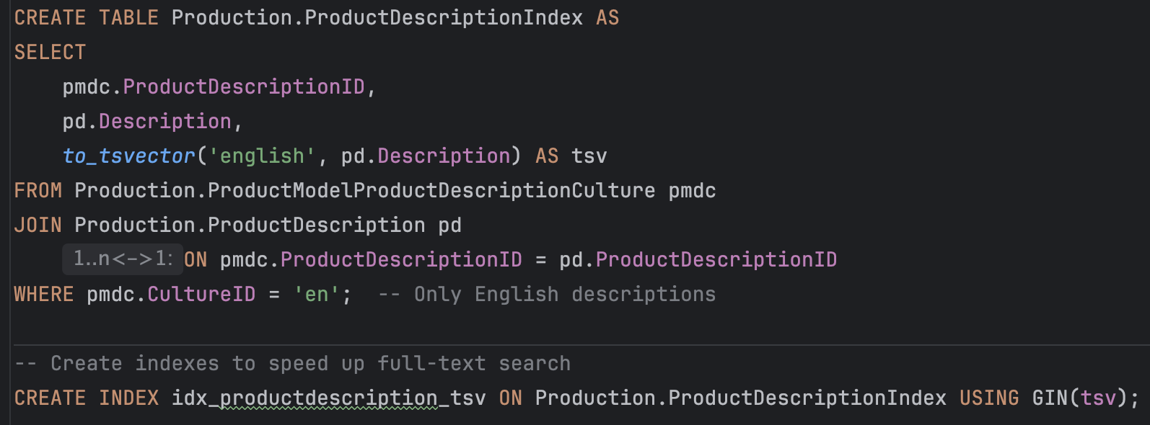
Data Preparation
Full-Text Indexing:
Created ProductDescriptionIndex tables to store tsvector representations for product descriptions and special offers.
Applied GIN indexes to enhance full-text search performance.

Slide 8
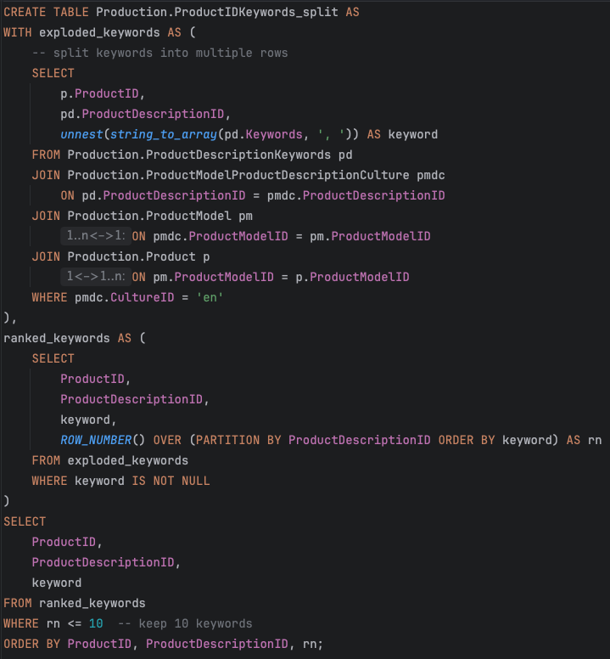
Data Preparation
Keyword Extraction from Product Descriptions:
Split long descriptions into individual keywords for better searchability and kept the top 10 keywords per product.
Order Duration Calculation:
Duration (ShipDate - OrderDate) measures the days between order and shipping, helping track delivery speed.
Both extracted keywords and order duration will be used as filter parameters in Neo4J to enhance recommendation relevance.

Slide 9
03
Relational Database Recommender

Slide 10
Part 1: Relational Database Recommender
Goal
$100M
Recommend products to customers based on purchase behavior, textual similarity, and category diversification.
Methodology
1️⃣ Content-Based Filtering
Extracted product descriptions and transformed them into tsquery format for full-text search.
Recommended products with similar textual descriptions to the target product.
2️⃣ Collaborative Filtering
Identified products frequently purchased together.
Ranked recommendations based on co-purchase frequency to highlight strong associations.
3️⃣ Diversified Recommendations
Balanced recommendations by including a mix of categories (e.g., bikes and accessories) to enhance variety.
Hybrid scoring model: Combined collaborative filtering and content-based similarity for ranking.

Slide 11
Key Step 1 – Content-Based Filtering
📌 Recent Purchase: Customer 29715 recently bought 🚴‍♂️ Road-350-W Yellow, 48 (ProductID 976).
💡 Method:
Convert product descriptions into a full-text search query using to_tsquery().
Rank products by text similarity using ts_rank_cd().
🔹 Recommendation Result (Text Similarity):
🚴‍♂️ Road-350-W Yellow, 40 (973)
🚴‍♂️ Road-350-W Yellow, 42 (974)
🚴‍♂️ Road-350-W Yellow, 44 (975)
These items are from the same series but differ in size, ideal for alternative sizing or family purchases.

Slide 12
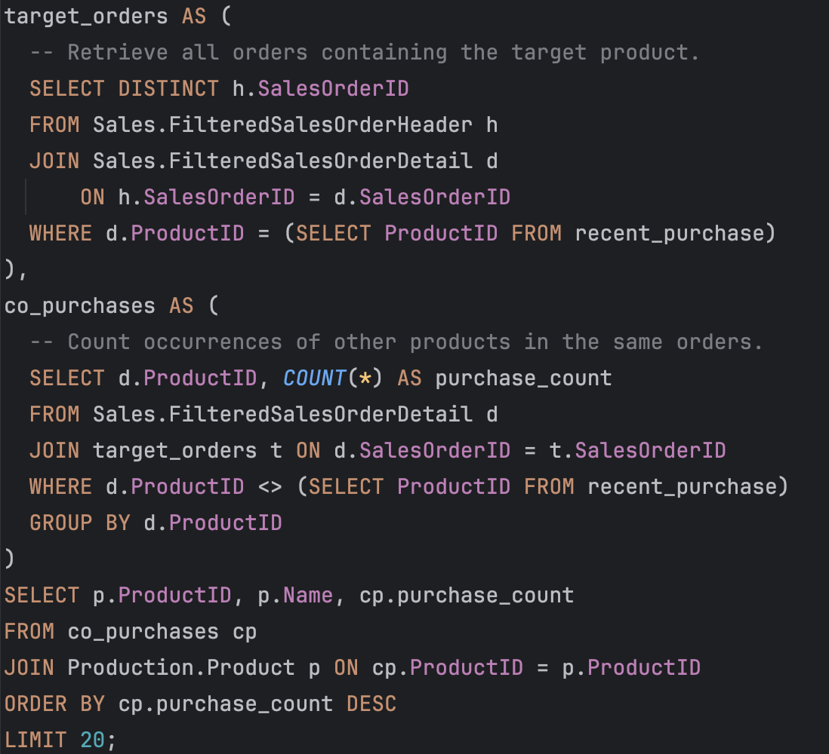
Key Step 2 – Collaborative Filtering
📌 Recommended items often bought together in the same orders.
💡 Method:
Identify orders containing the purchased product.
Find frequently co-purchased items from these orders.
Rank products by co-purchase frequency.
🔹 Recommendation Result (Co-Purchase Frequency):
🚴‍♂️ Road-750 Black, 48 (998)
🚴‍♂️ Road-550-W Yellow, 48 (801)
🚴‍♂️ Road-550-W Yellow, 38 (797)
💡 Insight:
These products are frequently purchased together with 🚴‍♂️ Road-350-W Yellow, 48.
Reflects market preferences for upgrades, brand loyalty, or complementary purchases.

Slide 13
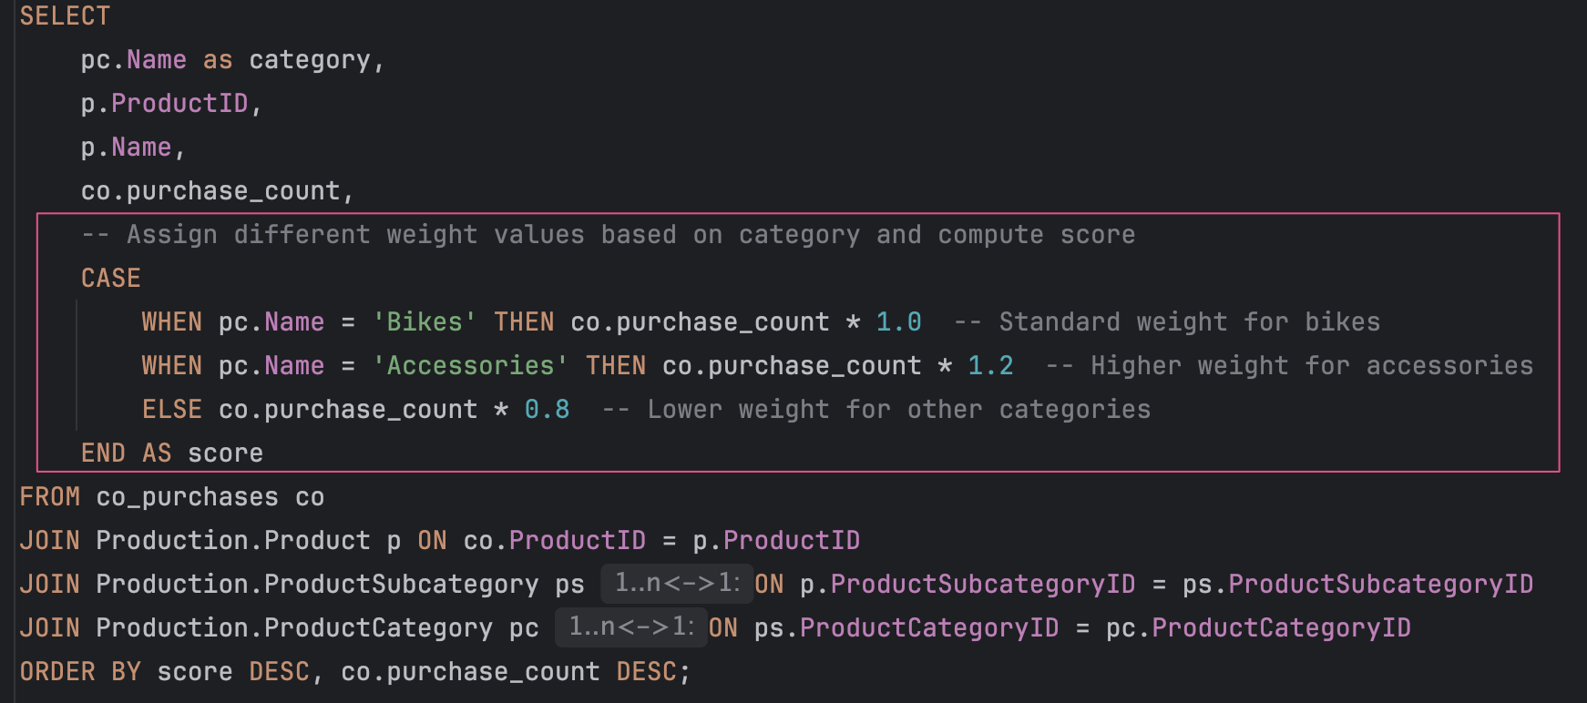
Key Step 3 – Diversify & Hybrid Scoring
📌 Increase variety by including both bikes and accessories, then re-rank using a combined score.
💡 Method:
Identify frequently co-purchased products from past orders and Assign category weights to balance bikes & accessories.
Compute hybrid scores based on purchase frequency and category adjustments.
Assign category weights to balance bikes & accessories.

Slide 14
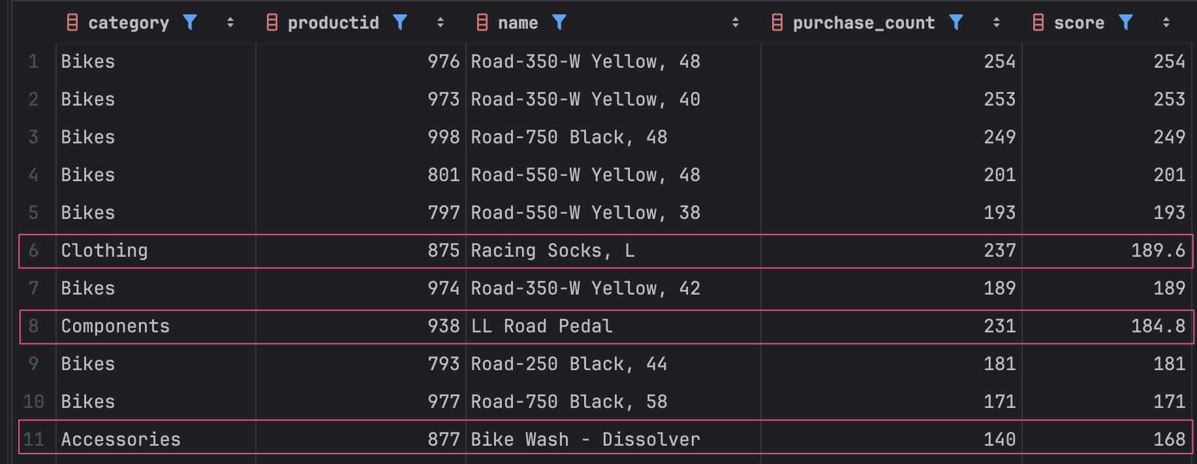
Key Step 3 – Diversify & Hybrid Scoring
🔹 Example Adjusted Recommendations:
a balanced mix of bikes & essential accessories
💡 Insight:
Beyond collaborative filtering, accessory items enhance diversity in recommendations.
Weighted scoring ensures a balanced mix of bikes & essential accessories, providing a more practical set of suggestions.

Slide 15
Next: Graph Database
Current Limitation of Relational Database
Our relational database approach generates recommendations but only shows the final results.
We lack clear visibility into the deeper relationships connecting customers, products, and purchase patterns.
Next Step: Neo4J Graph Database
Goal: Transform relational data into a graph to uncover hidden connections.
Why Neo4J?
Visualize nodes (customers, products) and edges (co-purchases).
Reveal relationship strength and centrality in ways a relational table can’t.
Enhance recommendation insights beyond simple lists of products.

Slide 16
04
Graph Database

Slide 17
INDEX AND RELATIONSHIPS
✅ Benefits of Index
Faster Lookups
Without an index, Neo4j performs a full graph scan to find matching nodes.
With an index, Neo4j quickly finds nodes based on indexed properties.
Optimized Filtering with WHERE
Queries with MATCH and WHERE run faster when indexed properties are involved.
Efficient Uniqueness Constraints
Indexes enforce uniqueness, preventing duplicate data.

Slide 18
OUR INDEX
We create index for our mainly used tables:
CREATE INDEX ProductionProductIndex FOR (p:ProductionProduct) ON (p.ProductID);
CREATE INDEX ProductionProductCategoryIndex FOR (pc:ProductionProductCategory) ON (pc.ProductCategoryID);
CREATE INDEX ProductionProductSubcategoryIndex FOR (psubc:ProductionProductSubcategory) ON (psubc.ProductSubcategoryID);
CREATE INDEX SalesSalesOrderDetailIndex FOR (od:SalesFilteredSalesOrderDetail) ON (od.SalesOrderDetailID);
CREATE INDEX SalesSalesOrderHeaderIndex FOR (oh:SalesFilteredSalesOrderHeader) ON (oh.SalesOrderID);
CREATE INDEX SalesSalesOrderHeaderWithDuration FOR (oh:SalesFilteredSalesOrderHeaderWithDuration) ON (oh.SalesOrderID);

Slide 19
INDEX AND RELATIONSHIPS
✅ Benefits of Relationships
Faster Query Execution
Neo4j traverses relationships directly instead of scanning all nodes.
Example: MATCH (c:SalesCustomer {CustomerID:123})-[:PLACED_ORDER]->(o:SalesFilteredSalesOrderHeader) RETURN o;
This query directly follows the PLACED_ORDER relationship without scanning all orders.
Graph Structure Optimization
Relationships store pointers to connected nodes, making traversals constant time (O(1)) instead of linear (O(n)).
More Meaningful Data Connections
Example: Instead of storing a customer-product mapping in a table, Neo4j represents it as: (Customer)-[:PLACED_ORDER]->(Order)-[:HAS_DETAIL]->(Product)

Slide 20
OUR RELATIONSHIPS
We create index for our mainly used tables:
(SalesCustomer)-[:PLACED_ORDER]->(SalesFilteredSalesOrderHeader)
(SalesCustomer)-[:PLACED_ORDER]->(SalesFilteredSalesOrderHeaderWithDuration)
(ProductionProduct)-[:HAS_KEYWORD]->(ProductionProductKeywords)
(ProductionProduct)-[:PART_OF_SUBCAT]->(ProductionProductSubcategory)
(ProductionProductSubcategory)-[:BELONGS_TO]->(ProductionProductCategory)
(SalesFilteredSalesOrderDetail)-[:HAS_PRODUCT]->(ProductionProduct)
(SalesFilteredSalesOrderHeader)-[:HAS_DETAIL]->(SalesFilteredSalesOrderDetail)
(SalesFilteredSalesOrderHeaderWithDuration)-[:HAS_DETAIL]->(SalesFilteredSalesOrderDetail)

Slide 21
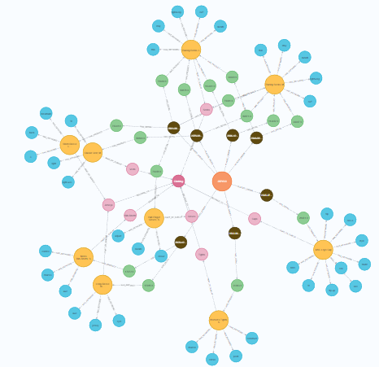
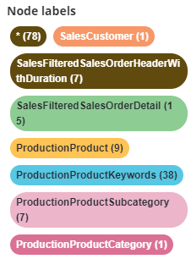
GRAPH VISUALIZATION
Overall connection with our mainly used tables (labels) for our interested customer

Slide 22
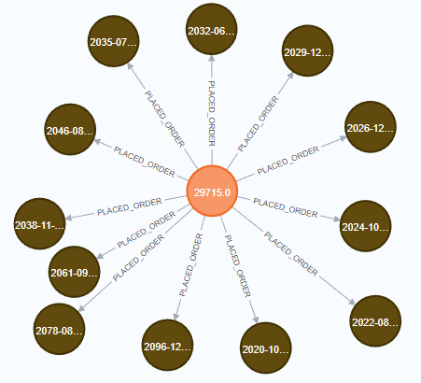
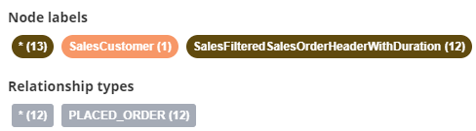
DETAILED GRAPH VISUALIZATION
Here is the graph connecting our interested customer and his all order headers
We fetch all orders placed by the customer with CustomerID: 29715. We can see the customer has placed 12 different orders each order is uniquely connected to the customer. The graph provides a clear visualization of customer transactions.

Slide 23
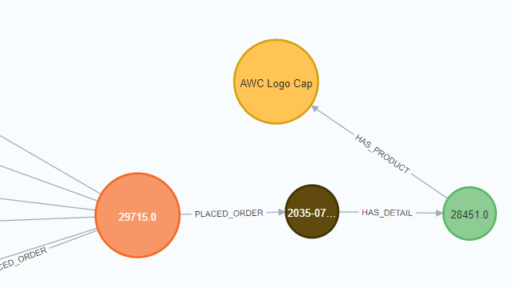
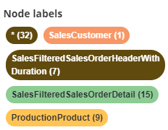
DETAILED GRAPH VISUALIZATION
Connecting our interested customer and the product he purchased
With Knowledge graph we can clearly see the route which shows how the customer is connected to the the produced he purchased. We can easily find which order and order detail is involved in the relationship.

Slide 24
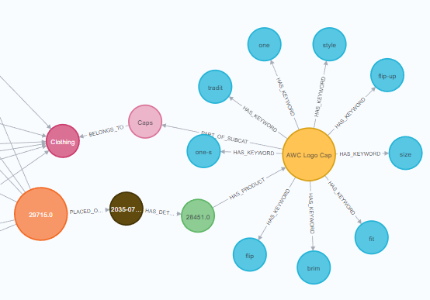
DETAILED GRAPH VISUALIZATION
More details such as category and product keywords
The meaningful relationship arrows gives clear view of details of the product such as category, subcategory and keywords of the product description

Slide 25
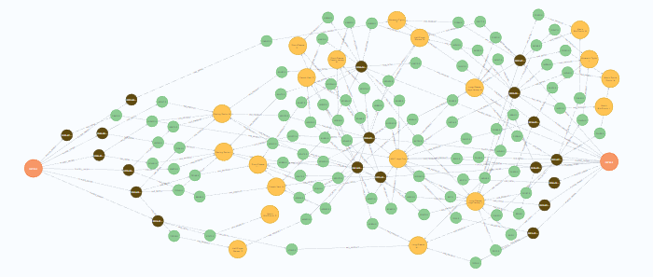
DETAILED GRAPH VISUALIZATION
Similar customers who purchased the same product
In this sub Knowledge Graph, we can see two customers (two orange nodes) are connected by the relation of purchased history of same products (yellow nodes). This is the intuition of Collaborative Filtering (Customer-Based Recommendations) for our recommend system.

Slide 26
WHY COMBINE SQL & NEO4J
Step | SQL Role | Neo4j Role
1️⃣ Extract User's Purchase History | SQL retrieves the customer's transaction history and product details. | ❌ Not needed (SQL fetches structured product data best).
2️⃣ Identify Similar Users | ❌ SQL is inefficient for this step. | Neo4j finds users with overlapping purchase history.
3️⃣ Find Products Purchased by Similar Users | ❌ SQL would require complex joins. | Neo4j retrieves products frequently bought by similar users.
4️⃣ Retrieve Detailed Product Info | SQL fetches structured product keyword extraction.. | ❌ Not needed (SQL does this best).
While SQL is suitable for fetching structured data such as users transaction history and product description keywords, it is slow and requires multiple joins to find similar customers and products, so we combine these two DBMS together for better performance

Slide 27
WHY COMBINE SQL & NEO4J
Real-World Use Cases:
Amazon, Netflix → SQL for transactions, Neo4j for personalized recommendations.
LinkedIn, Facebook → SQL for user profiles, Neo4j for "People You May Know".
E-commerce Platforms → SQL for product storage, Neo4j for "Customers who bought this also bought...".

Slide 28
05
Neo4j Recommender

Slide 29
Overview of the Recommender System
Goal
$100M
Recommend products to customers based on purchase behavior, category preferences, and lead time
Technologies Used
Neo4j (Graph Database) & Python (for querying and processing recommendations)
Key Features
Collaborative filtering based on purchase history
Category-based filtering and Keyword-based matching for relevance
Time-based filtering to improve recommendations

Slide 30
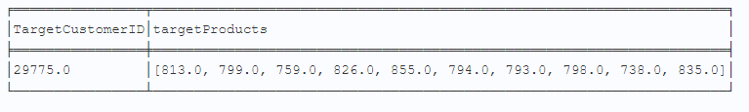
📌 Step 1: Find Products Purchased by the Target Customer
Key Cypher Query Breakdown
Explanation:
Filters customer purchases within the allowed duration
Collects distinct products bought by the target customer

Slide 31
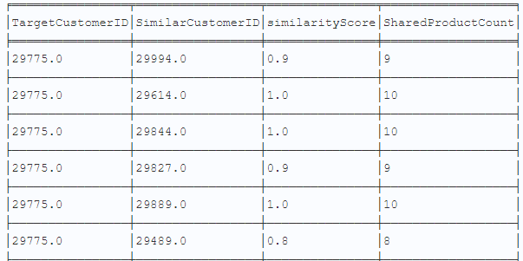
📌 Step 2: Find Similar Customers & Their Purchases
Key Cypher Query Breakdown
Explanation:
Finds other customers who purchased the same products as the target customer
Filters only purchases that were shipped within max_duration
Scores similarity based on the number of shared products

Slide 32
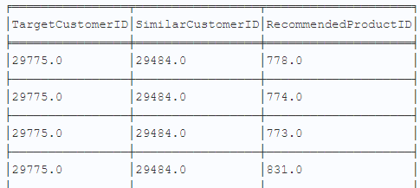
📌 Step 3: Find Products Not Yet Purchased by the Target Customer
Key Cypher Query Breakdown
Explanation:
Identifies new products that have been purchased by similar customers but not yet by the target customer

Slide 33
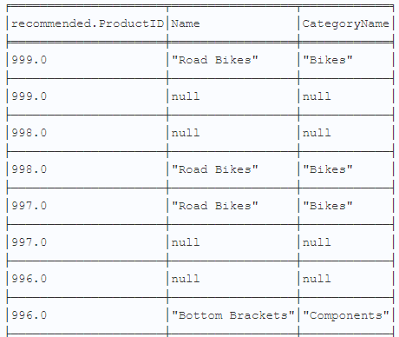
📌 Step 4: Get Product Category Details
Key Cypher Query Breakdown
Explanation:
Retrieves subcategory and category details for the recommended products

Slide 34
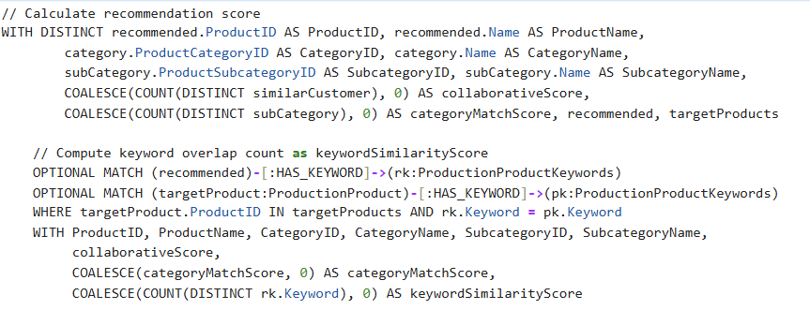
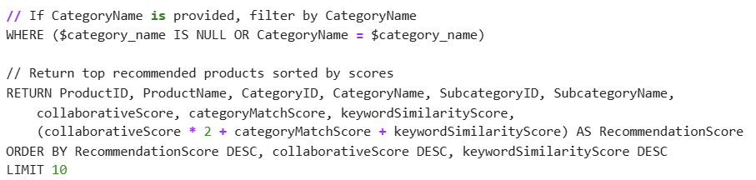
📌 Step 5: Generating Product Recommendations
Key Cypher Query Breakdown
Explanation:
Scores products based on collaborative filtering—how many similar customers bought the product
Measures keyword overlap between the target customers’ purchased products and the recommended products
Optional Category Filtering

Slide 35
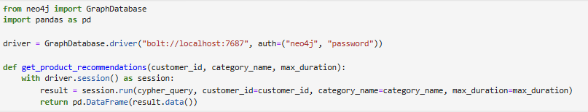
Python Integration for Query Execution
SQL preprocessed output file import to Neo4j
Connects to Neo4j
Executes the Cypher query
Returns recommendations as a Pandas DataFrame

Slide 36
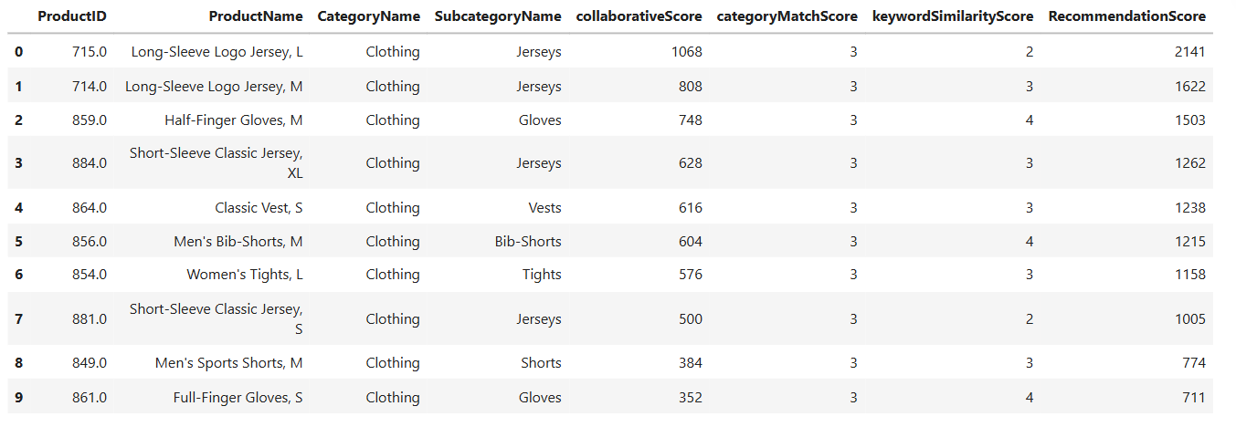
Demonstration of the Recommender System
Example Input
Customer ID
Category Name
Max Duration
29715.0
'Clothing'
9
Notes:
the top 10 product recommendations for customer 29715 in the Clothing category, considering ship made within 9 days

Slide 37
Future Works
Enhanced Personalization
$100M
Incorporate additional customer attributes, like supplier and price preferences
Real-Time Recommendations
Implement streaming data integration to provide recommendations based on live customer interactions

Slide 38
Thanks!

